Slide 1
Path Mapper
By Loc Huynh, Zachary Serna, Bereket Teweldebrhan, Manuel Vargas
Notes:
Zac

Slide 2
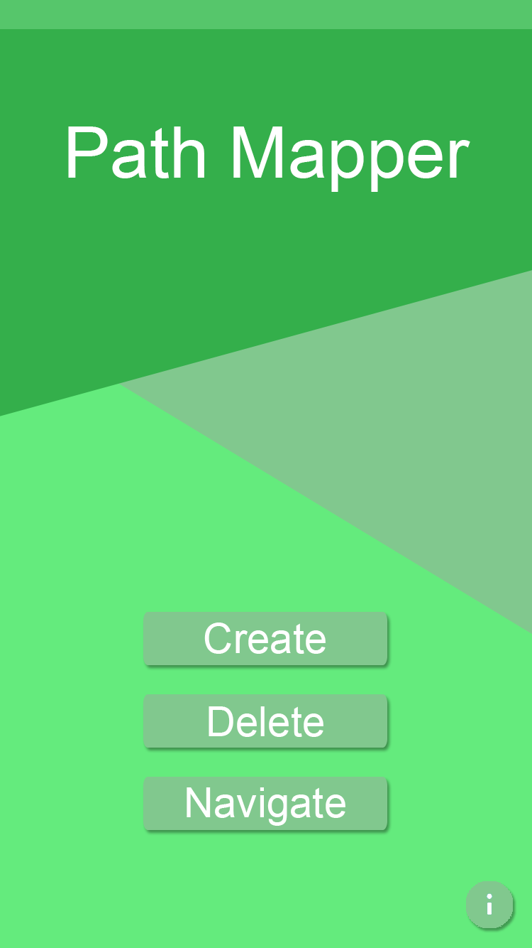
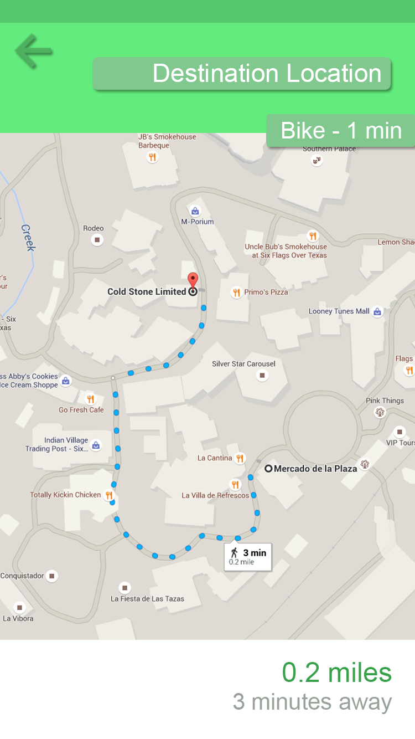
What is Path Mapper?
Android app developed using Android Studio in Java
Helps people get to previously unmapped areas. If an area hasn’t been mapped, then it allows the user to participate in creating a path to that location.
Notes:
Zac

Slide 3
Functional Requirements

Slide 4
Precision Crowd-Sourced Data
Purpose:
To provide an accurate network of paths, it will be necessary to hone in on the phone location with precision, so that any paths that are eventually created by our algorithms are accurate and do not pull in any unneeded geo-points.
Function:
The application, using fine GPS location tracking, will track the user's mobile device up to three meters of distance to assure precision in the geo-point that will be sent to the external database.

Slide 5
Path Search
Purpose:
To facilitate the correct path to be chose to a location, the desired location will be searchable via in application search bar which will return potential location points for the user to choose.
Function:
The application shall utilize a search function to choose from a current list of database stored location which a user will choose from as desired by them.

Slide 6
Path Creation
Purpose:
After the location has been chosen, if it exist in the database, the system will provide all necessary geo-points to the user's mobile device which will calculate the shortest path to that particular location given their current location.
Function:
The application shall create the shortest path given geo-points local to the current location. (The Function to provide the shortest path is to be determined)

Slide 7
Database
Purpose:
Similar to other services that provide mapping systems, the whole of all the data collected will be stored on an external cloud based database so that users may upload and download only the necessary geo-points for their location to prevent a user from having to store the whole of the database locally on their mobile device.
Function:
The application shall store geo-points collected during location tracking to a external cloud based database (TBN), which will facilitate the necessary geo-points the location requires to create an effective path. These points should only be stored initially on the mobile device for the duration of the initial path tracking, and then for the shortest path generation.

Slide 8
Current Navigated Path
Purpose:
To provide a sense of location and direction, the system will display the user within the map based image on the mobile device so that the user to view his or her progress to their destination.
Function:
The application shall provide a visual representation, such as a map view, of the user's current location relative to the path they will be following to their destination, to provide a sense of direction and progress.

Slide 9
Non-Functional Requirements

Slide 10
Menu Simplicity
Purpose:
Similar to the overall aesthetic, the items within the menus and prompts should be to the point, but long enough to provide a complete understanding of each item the user will chose. This will prevent user confusion, and keep users from providing incomplete information because of their lack of understanding with the system.
Function:
The application shall provide users with menus which are succinct but provide the users with the proper information to explain the menu options function.

Slide 11
Performance
Purpose:
Providing a fast experience will convince users to return to the application, as well as to help provide an accurate and fast location path query.
Function:
The application and external cloud based database shall provide a search result for a location or provide the user with the next step in the process in approximately five seconds.

Slide 12
Power Consumption
Purpose:
The system need to be minimal in power consumption so the users mobile device does not become drained by limited use of our application.
Function:
The application shall keep GPS location tracking to a minimum to assure minimal use of the battery, saving battery life.

Slide 13
User Identification
Purpose:
Within the cloud database, users will be identified with an ID number based on the mobile device they are using; however, no database of user names or alias will be kept to provide more privacy for users who will be supporting the system by providing tracking.
Function:
The system shall not provide any name or alias tracking to prevent invasion of privacy for the user.

Slide 14
Administrative Backend
Purpose:
To prevent the administrators of the system from having to manually remove database elements, a simple interface will be built to alter database elements as well as provide testing to the system as a whole.
Function:
The system shall provide an administrator panel to which those who manage the software can provide updates, remove database elements, and tests the system.

Slide 15
Constraints

Slide 16
Constraints
No external feedback from clients
Lack of testing devices
Location use bound to external use
Processing power of device

Slide 17
Data Elements

Slide 18
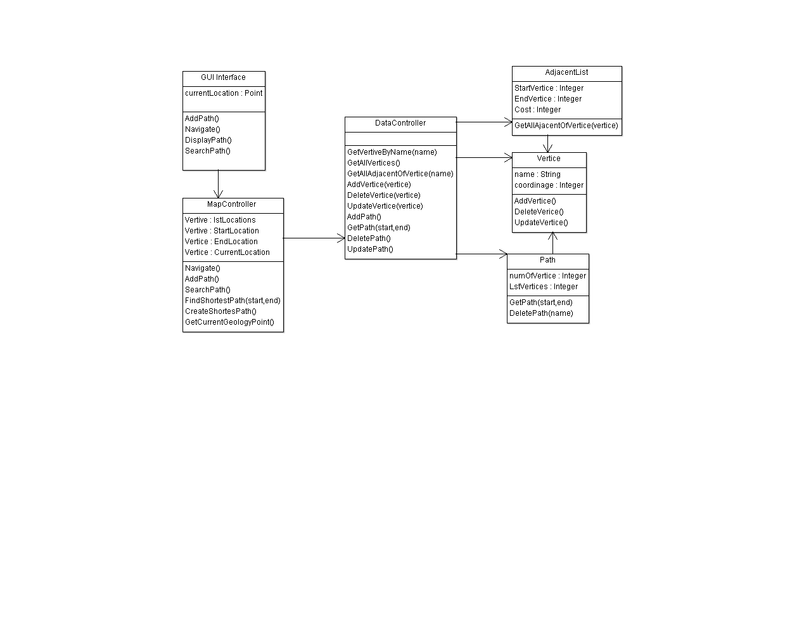
Class Diagram

Slide 19
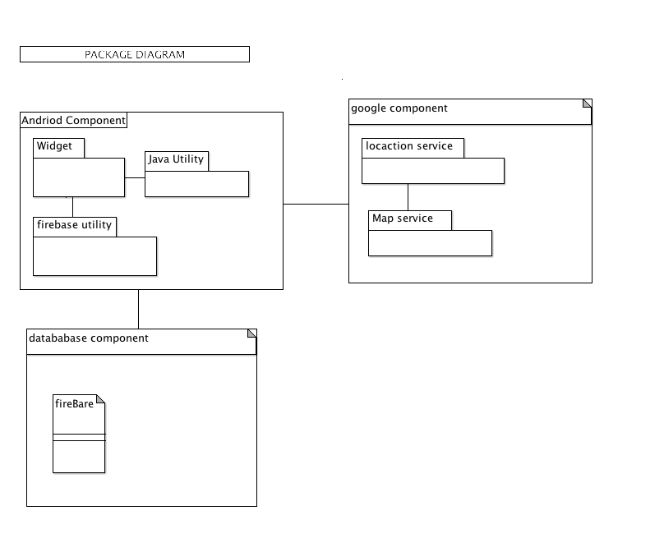
Package Diagram

Slide 20
State of the Application
Notes:
Zac

Slide 21
Current Challenges and Future
Continued integration with Database
Implementing shortest path to destination. (Processing?)
Geopoint oversaturation and recalculation.
Notes:
Zac

Slide 22
Scope Changes
Limiting shortest paths to shortest overall path. Save multiple paths for later versions
Limit calculations and recalculations due to processing ability.
External interface not included initially. Modifications will be handle by database functions.
Notes:
Zac

Slide 23
Completion
With recent progress, the project will be completed. Next progress will have the team:
Store recent path created nodes to database
Ready for database upload function implementation.
On search, download necessary location nodes
Calculate shortest distance to destination
Create navigation path to location (easy).
Notes:
Zac

